Slide 1

The Battle of Neighborhoods – Toronto vs NYC
Hareen Subramaniam
27/6/2021

Slide 2
Background/Problem Statement
New York City and Toronto are two large cities which are well-known and can be quite attractive to immigrants from many countries around the globe.
Both cities in the past couple of decades have been home to many immigrants around the world. Each of these two cities are unique to their own heritages.
If one were thinking about migrating to either cities, which would be the better city to live in?
With a wide range of data and tools to process and analyze them from our data science toolbox, we will be exploring how similar/dissimilar they are to one another with regards to common venues for food, tourist attractions, and more

Slide 3
Data acquisition and cleaning
Pulling data from previous course labs such as the New York/Manhattan dataset and the Toronto dataset provided by the .csv file
  Webscrape data from Wikipedia for Toronto and utilize data from Coursera lab for New York
Remove erroneous data, combine neighborhoods which have same neighborhood coordinates for each borough and remove “Not Assigned” neighborhoods
Transform data into usable format i.e dataframe using Pandas

Slide 4
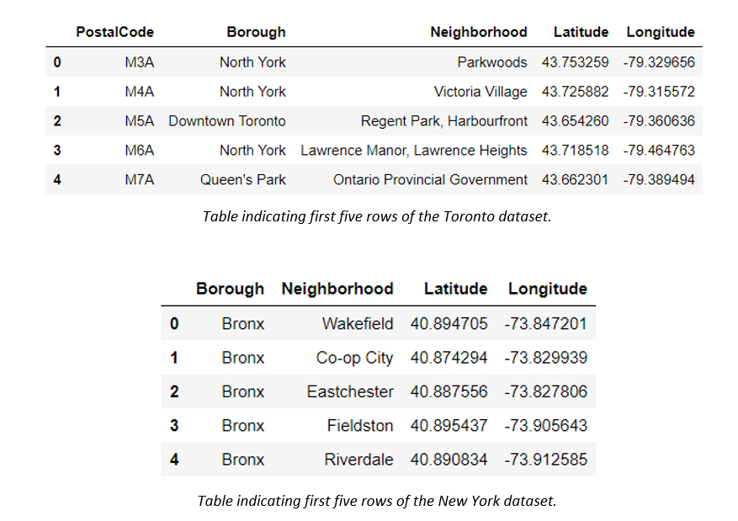
Data acquisition and cleaning cont.
Tables after preprocessing should look like this:

Slide 5
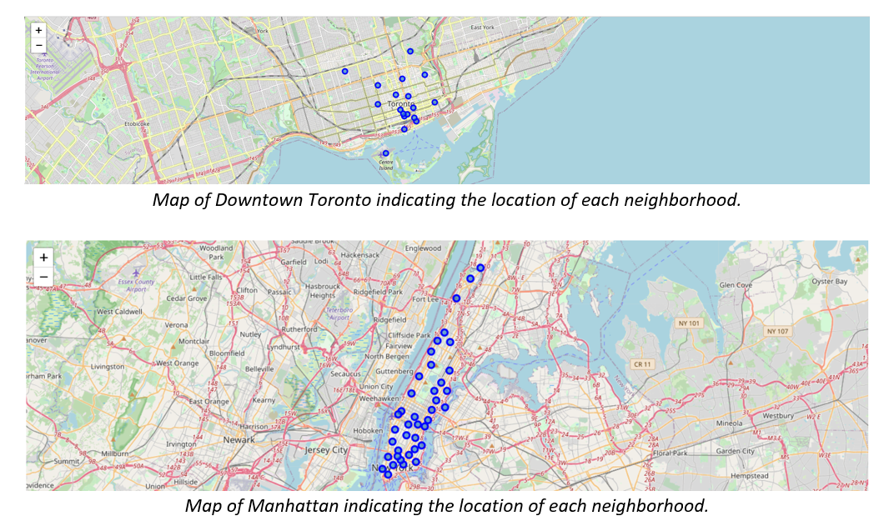
Visualize coordinates on Map

Slide 6
Analysis
Foursquare API was utilized to pull common venues for each neighborhood
Using one hot encoding, each neighborhood was assigned a dummy variable within vicinity of each neighborhood and after, top 10 most common venues were tabulated

Slide 7
Clustering
Algorithm applied: K-means clustering
In both cities, k-means = 5 (was assigned by trial and error)
New dataframe was created by grouping common venues, initial dataset (with coordinates, boroughs and neighborhood names) and cluster labels

Slide 8
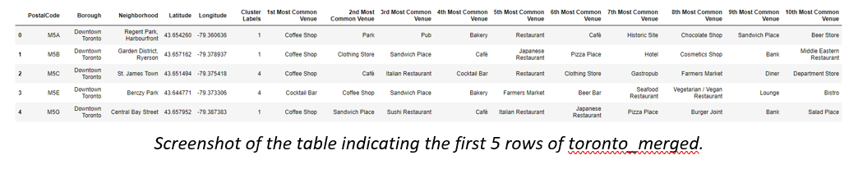
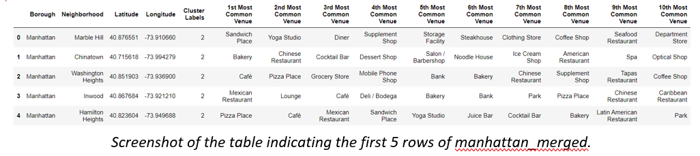
Clustering - Continued

Slide 9
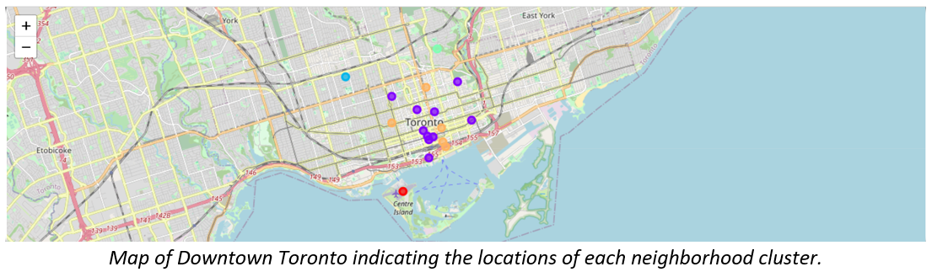
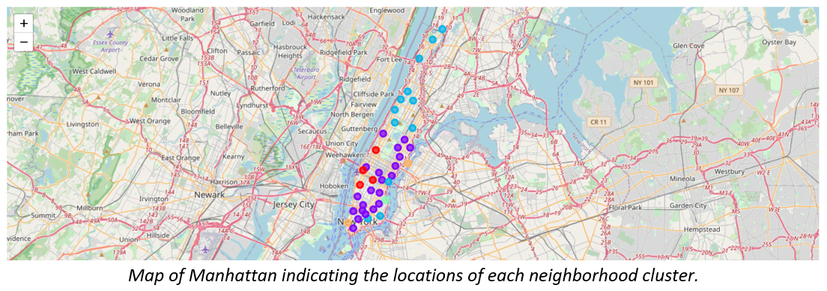
Visualization from k-means clustering

Slide 10
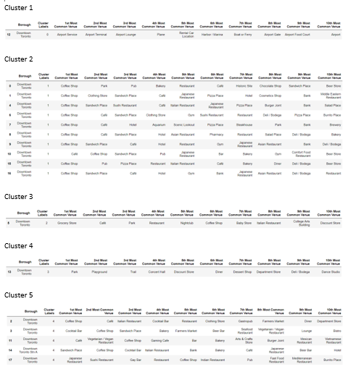
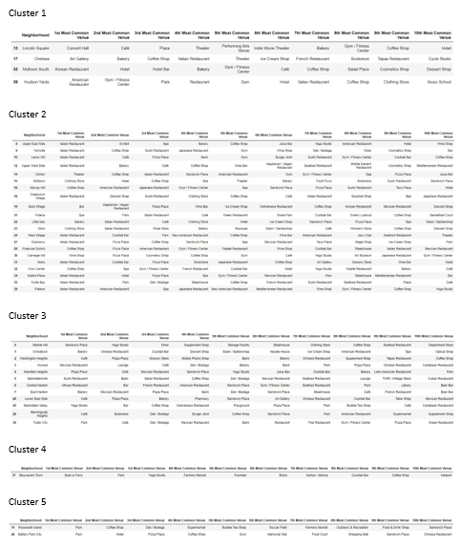
Results from analysis
Downtown Toronto dataset:
Manhattan dataset:

Slide 11
Toronto Results
Cluster 1 - common venues were those of airport relation
Cluster 2 – Common venues are coffee shops, parks, sandwich places over 10 boroughs
Cluster 3 & 4 – Singular borough (cluster 3 is similar to cluster 2, however, cluster 4, top 3 common venues were park, playground and trail)
Cluster 5 – 5 boroughs which have diverse set of venues ranging from coffee shops, to cocktail bars and diverse restaurants

Slide 12
Manhattan Results & Discussion
Cluster 1, 2 & 3 – Both have many neighborhoods within their vicinities such as concert halls, art galleries, diverse restaurants
Cluster 4 & 5 – Only 1 or 2 neighborhoods
  Cluster 4 - the common venues are boat/marina related which suggests neighborhood is near to the pier
  Cluster 5 – common venue is close to the park for both neighborhoods

Slide 13
Observations & Recommendations
Toronto seems to be a quieter and calmer city compared to New York city. They both have pretty similar venues but it does seem that there are far more tourist attractions in the city of New York than in Toronto.
For someone who loves the hustle and bustle lifestyle or would love to open a restaurant for the purposes of immigrating, the city of New York would seem more appropriate to be the recommendation to migrate to. Specifically, clusters 2 or 3 as they seem to be the best amongst the five clusters that were analyzed due to the proximities of many common venues to those neighborhoods.
However, for someone who loves city lifestyle but rather not so “on-the-go”, Toronto would be more suitable. Cluster 1 would not be highly recommended as it is close by the airport which results in a lot of traffic noises which could be quite distracting and annoying. The best clusters would be cluster 2 as there are coffee shops, parks, sandwich places or cafes for over 10 boroughs.

Slide 14
Conclusion
Both cities have their similarities as well as their dissimilarities.
From one aspect, in terms of common venues, both cities have cafes, parks, coffee shops, gyms, shops, restaurants, etc.
However, the difference lies were in historical landmarks and tourist attractions.
From the maps, we can see that the island of Manhattan has a lot of venues for a smaller land area compared to Downtown Toronto.
In terms of migration, if migrating to settle down in a quieter neighborhood, Toronto would be a more suitable city to do so. However, for the purposes of migrating in opening a restaurant, museum, etc. both cities are appropriate.

